Slide 1

LINUX – NETWORKING ON LINUX
Docente: Dott. Daniele Gobbo Modulo 3

Slide 2
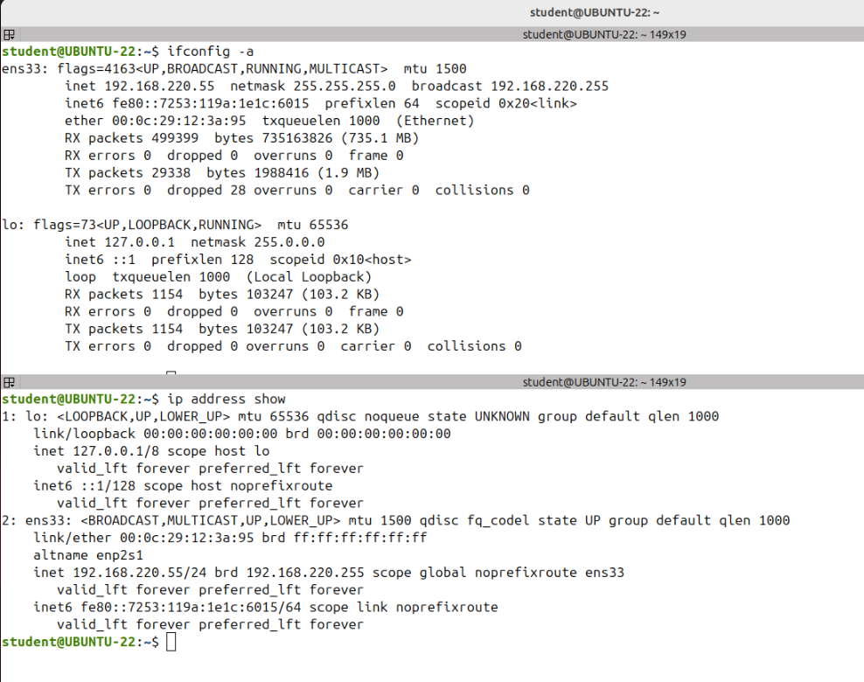
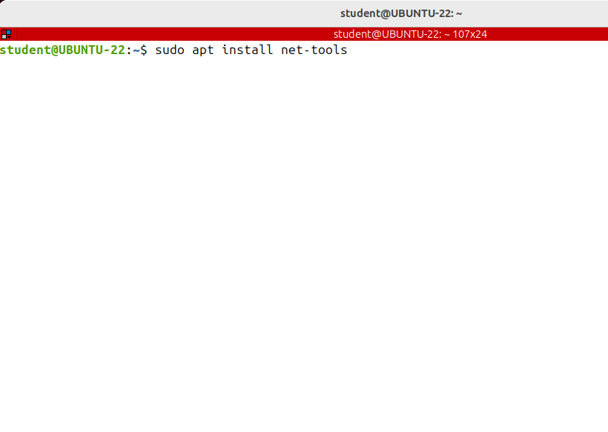
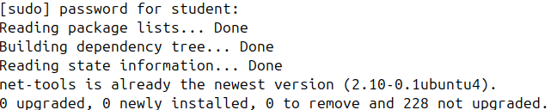
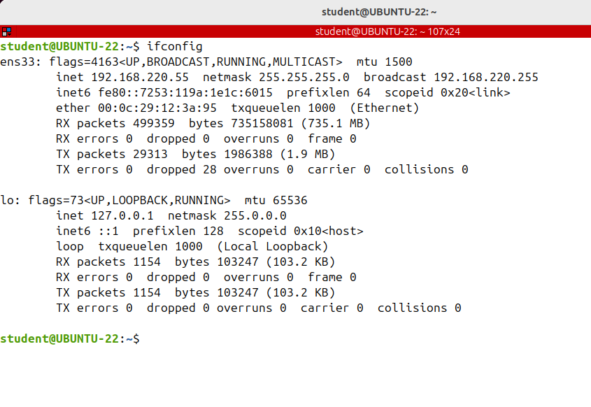
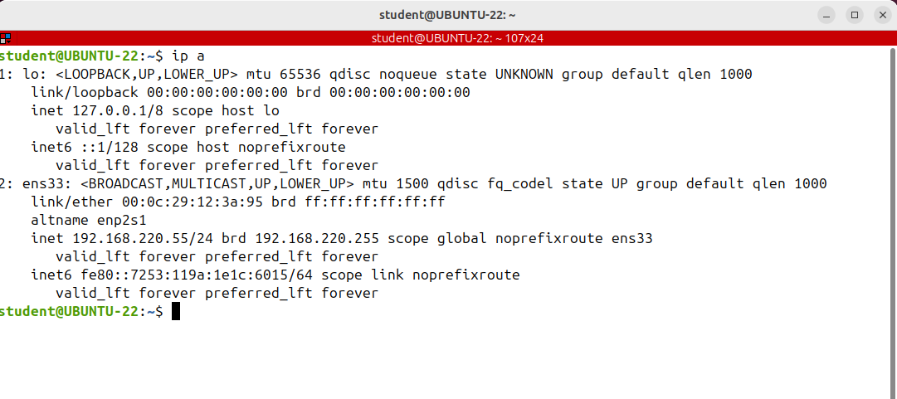
Getting Information about the Network Interfaces (ip, ifconfig)
will show you how to get the needed information about the network interfaces.
Basically there are two commands ifconfig and ip.
I've got the same information, but in different formats.
The -a flag of ifconfig makes it display the information about all interfaces, both enabled and disabled.
If you omit the minus option I have config will show only the information about enabled interfaces.
Ipconfig is part of net tools package has been there for a long time and is still used to configure display and control network interfaces by many Linux administrators.
However, there is a new alternative the IP command from IP tool package.
Note that net tools is not installed by default on Ubuntu desktop edition and if you want to use the ifconfig command you have to install it.

Slide 3
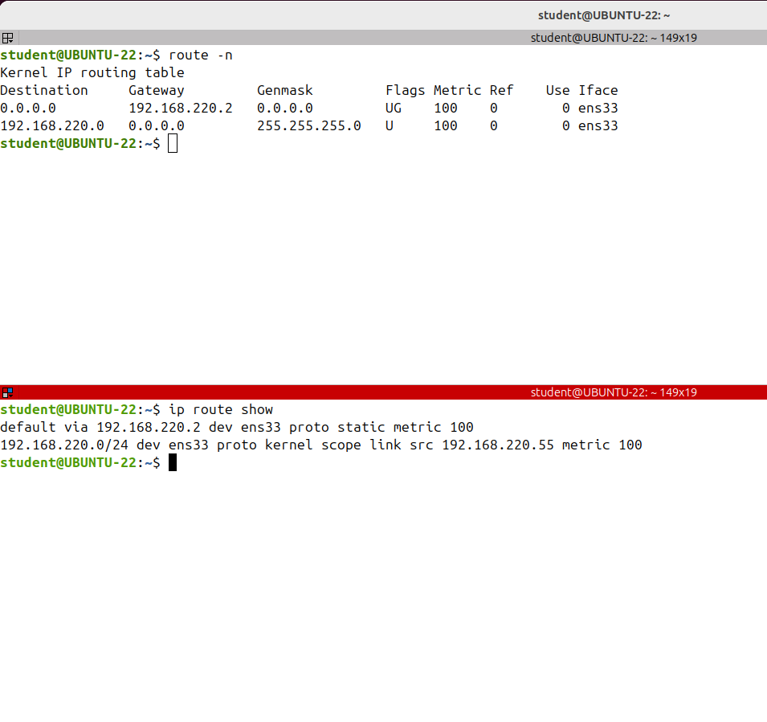
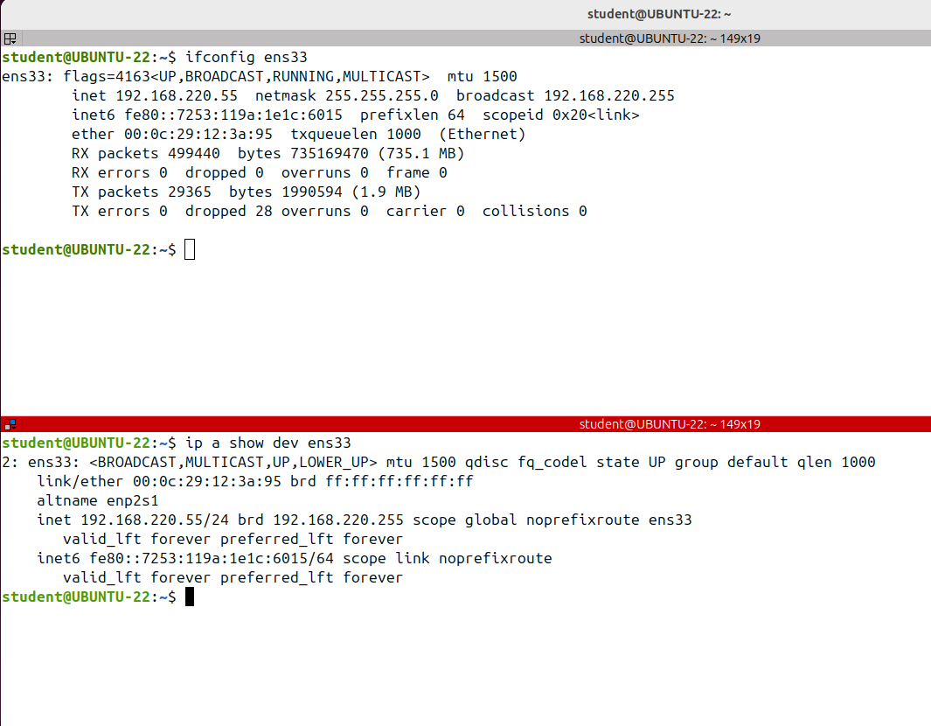
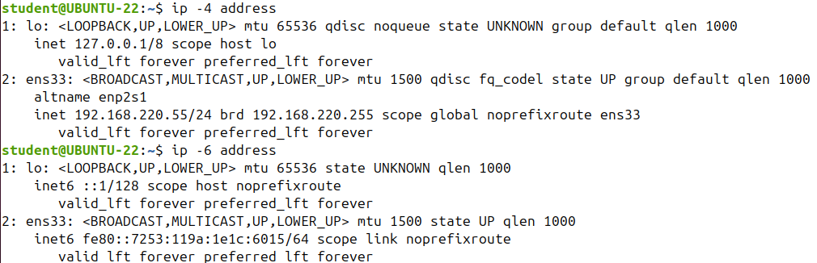
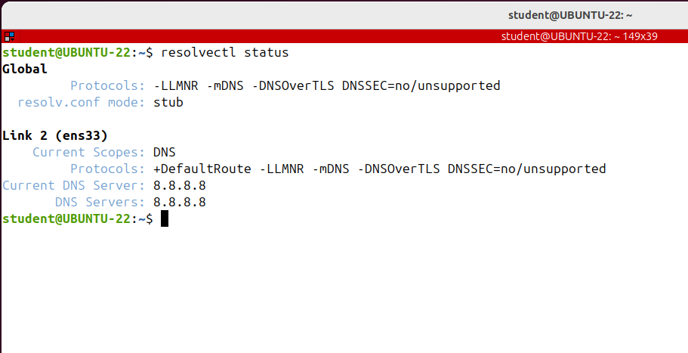
Getting Information about the Network Interfaces (ip, ifconfig)
Let's move to DNS on the latest versions of Ubuntu.
The DNS is under the control of systemd resolve daemon.
This is a service that provides DNS name resolution to local services and applications and it can be configured with netplan.
Netplan is the default network management tool on ubuntu will talk about netplan and how to statically configure
a network interface, including DNS name servers
To properly communicate on the Internet.
Your system also needs a default gateway, and the DNS server I have configured can display neither the default gateway nor the DNS server.
But there's the route command from the same package called Net Tools.

Slide 4
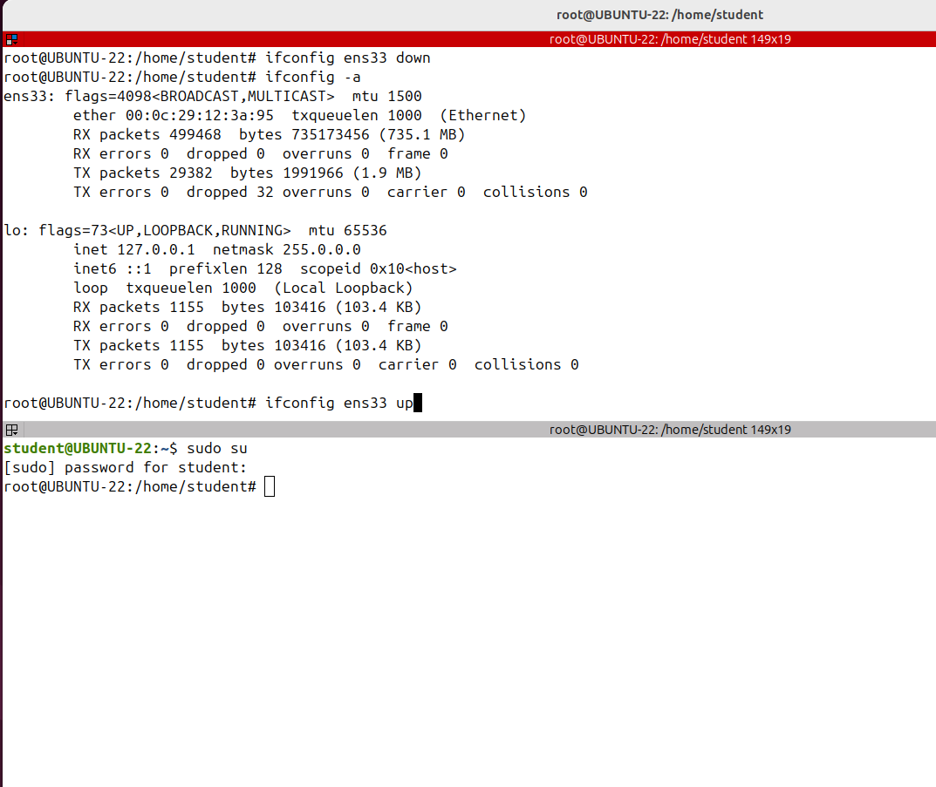
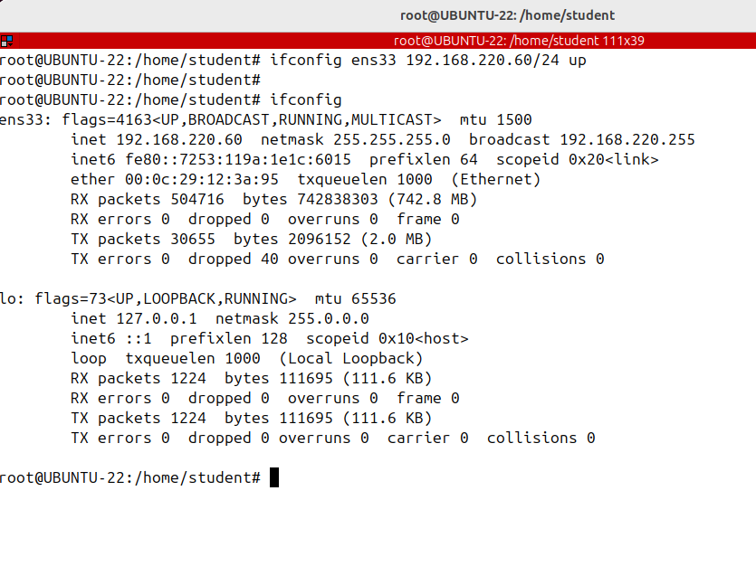
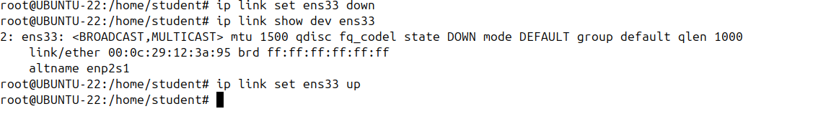
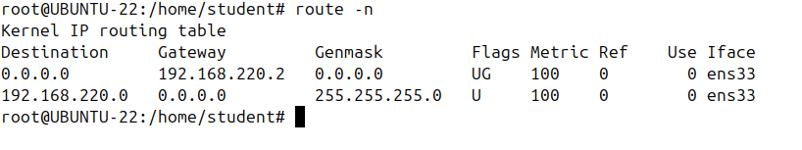
Configuring the Network On The Fly (ifconfig, ip, route)
When configuring network interfaces using ip
or ifconfig commands, you must execute the commands as root, otherwise you get an “Operation not permitted” error.
Let's go ahead and configure an IP address on the interface; note that the configurations set with the ip and ifconfig commands are not persistent.
After a system restart, all changes will be lost; for permanent settings you need to edit a distro specific configuration file.
For example, on Ubuntu, you have to use a net plan for a static configuration of the network.

Slide 5
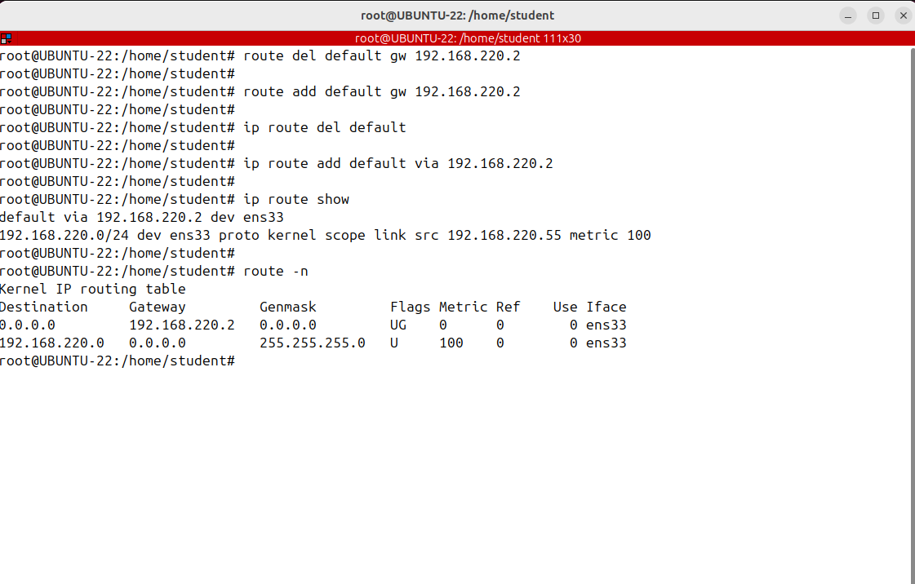
Configuring the Network On The Fly (ifconfig, ip, route)
Let's see how to change the default gateway
If there is already a default gateway configured, then we have first to remove it

Slide 6
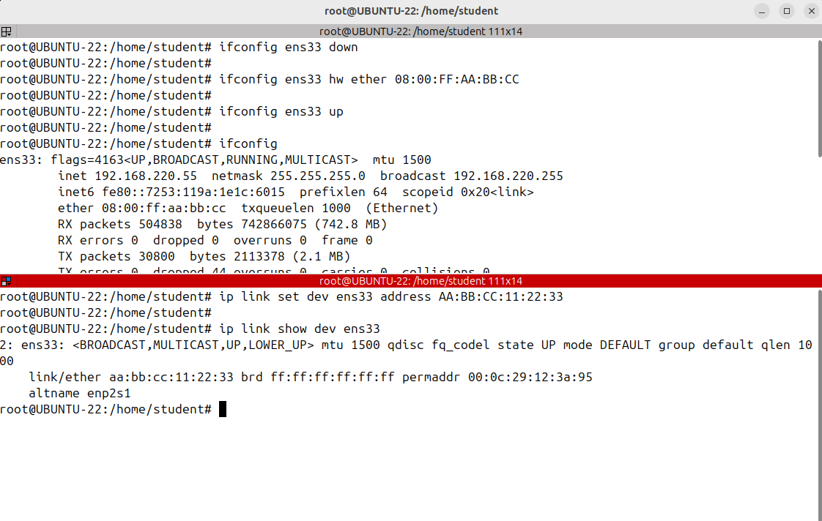
Configuring the Network On The Fly (ifconfig, ip, route)
let's see how to change the MAC address of an interface: the first step is to disable the
interface.
note to the configuration is valid
only up until a new restart.

Slide 7
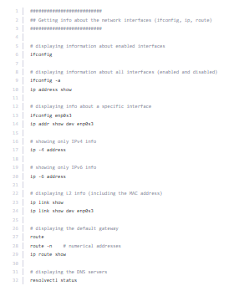
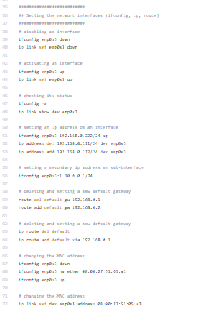
COMMANDS

Slide 8
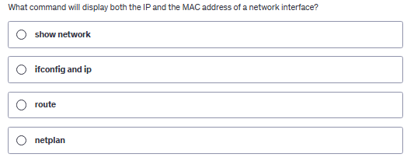
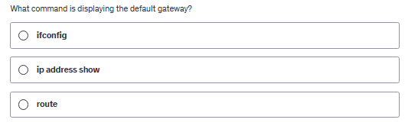

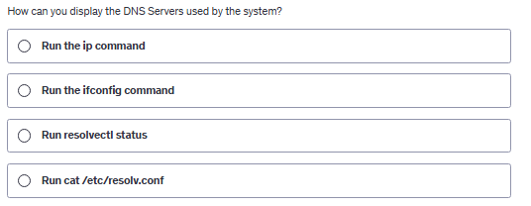
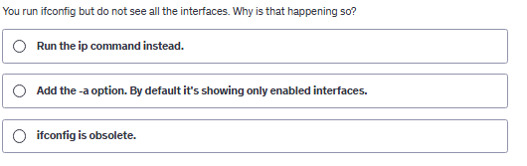
QUIZ

Slide 9
Setting Up Static IP on Ubuntu (netplan)
I'll show you how to statically configure a network interface. Typically laptops
and desktops have their IP address assigned dynamically by a DHCP server which is in most cases the router.
However, a server requires a static configuration to avoid the single point of failure problem of using DHCP server.
Since the release of Ubuntu 17.10, NetPlan is the default network configuration tool to
manage networks.
Netplan currently supports to renderers or backend services to control network interfaces on Ubuntu based systems.
NetworkManager and Systemd-networkd.
The Network Manager is mostly used on desktop machines while systemd -networkd is used on servers without a GUI.

Slide 10
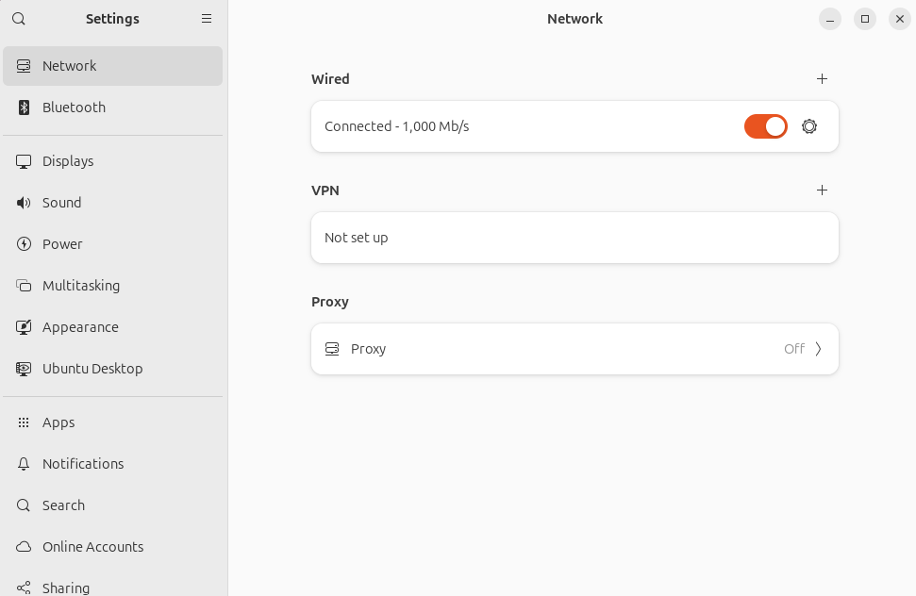
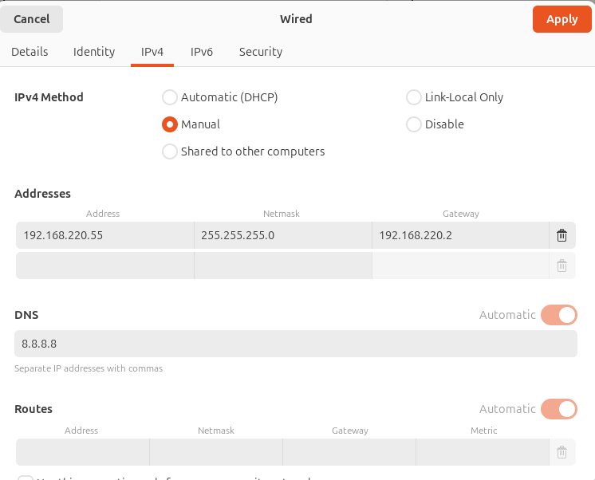

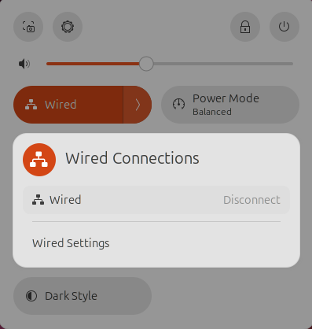
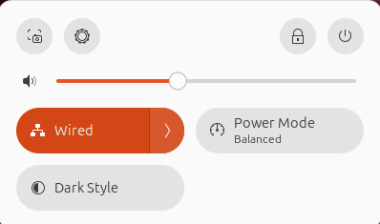
Setting Up Static IP on Ubuntu (netplan)

Slide 11
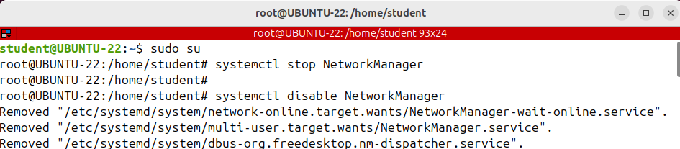
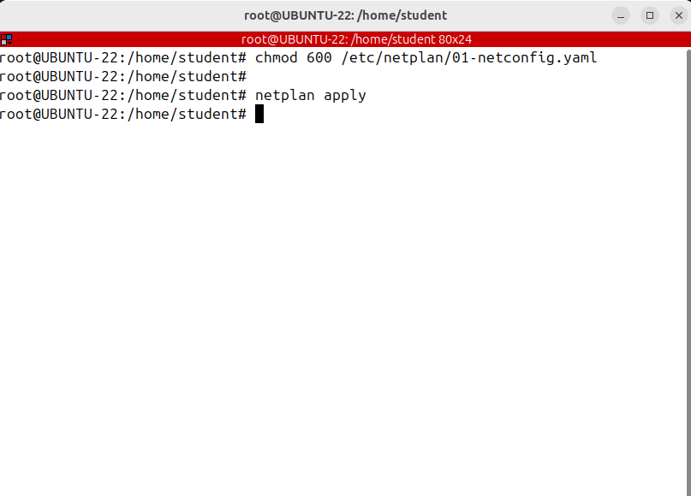
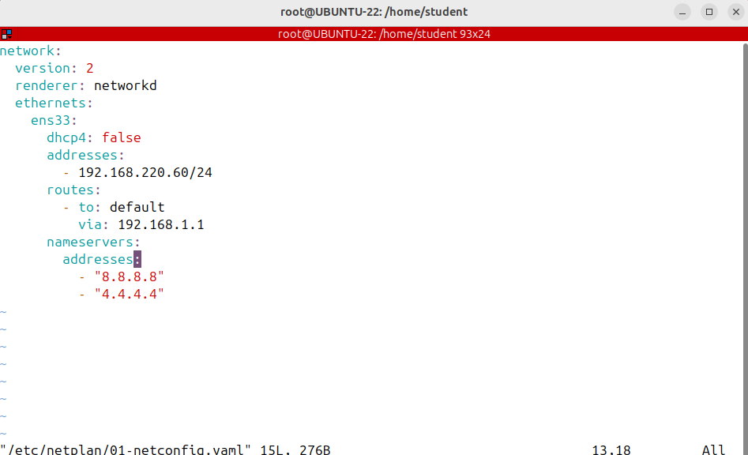
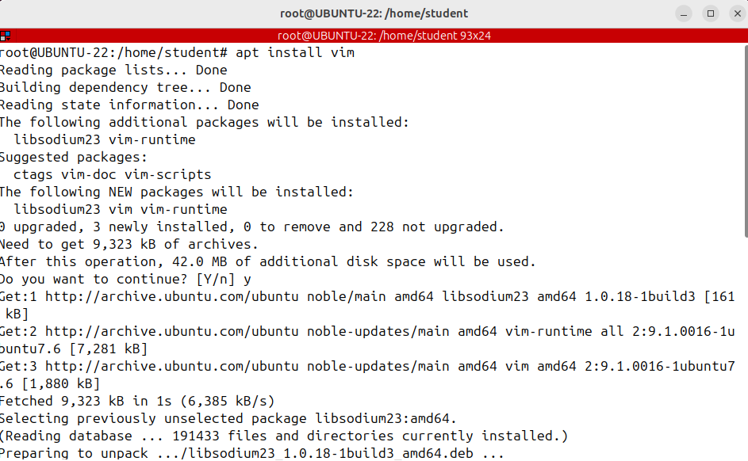
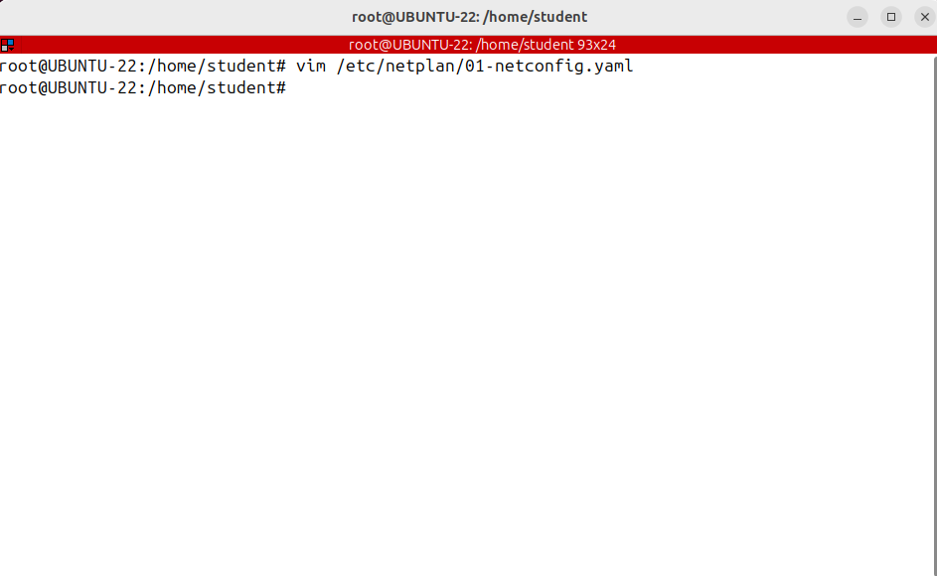
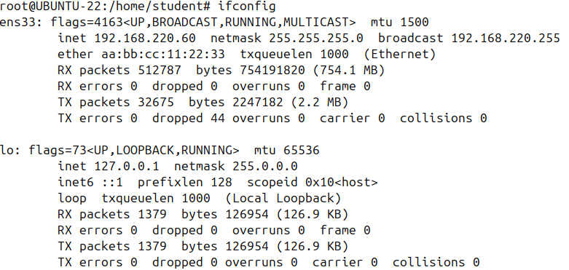
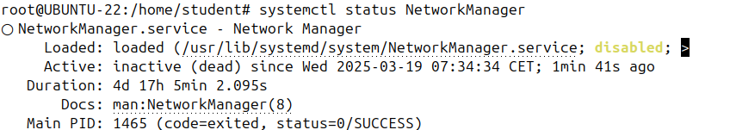
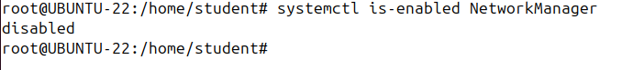
Setting Up Static IP on Ubuntu (netplan)
Let's move ahead and see how to configure the network interface on a server if there is no GUI available using the systemd, the networkd renderer.
The first step is to disable the network manager.
The network interface can be managed either by network manager or by networkd, but not by both of them at the same time.
The next step is to create a yaml file in /etc/netplan, and if you don't use the network manager renderer anymore my advice is to remove the existing yaml file for a network manager that exists in in /etc/netplan
That file could interfere with your static configuration.
So vim/etc/netplan and the file name, you can name it something like a 01-netconfig.
Yaml Inside the file, I'll paste some lines.
Please save the file- :wq

Slide 12
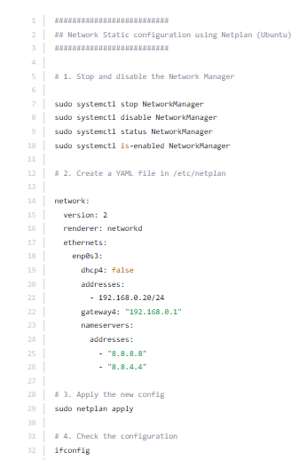
COMMANDS netplan

Slide 13
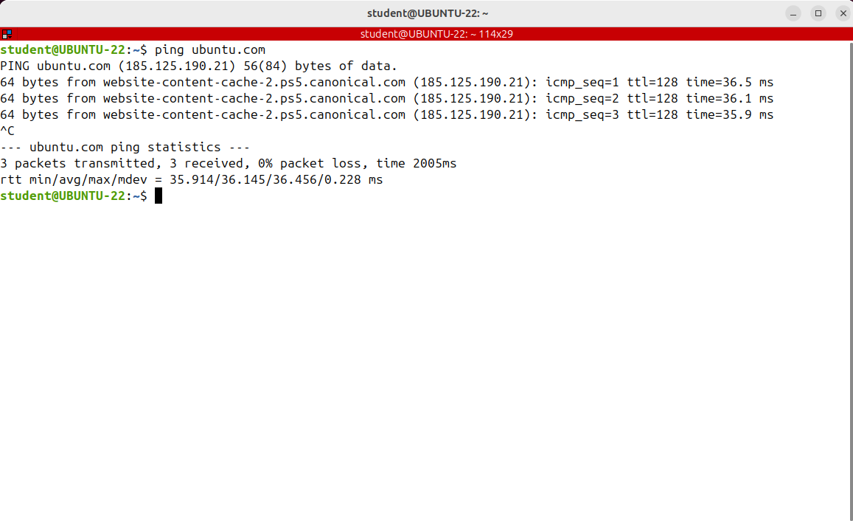
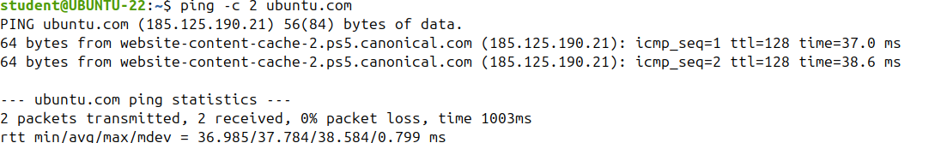
Testing and Troubleshooting Network Connectivity
The most useful utility for testing and troubleshooting network connectivity issues is Ping.
A time less than 30 is excellent.
30 to 50 milliseconds is average
value greater than 100 means a slow response.
And probably you cannot run real time applications like voice or video over IP

Slide 14
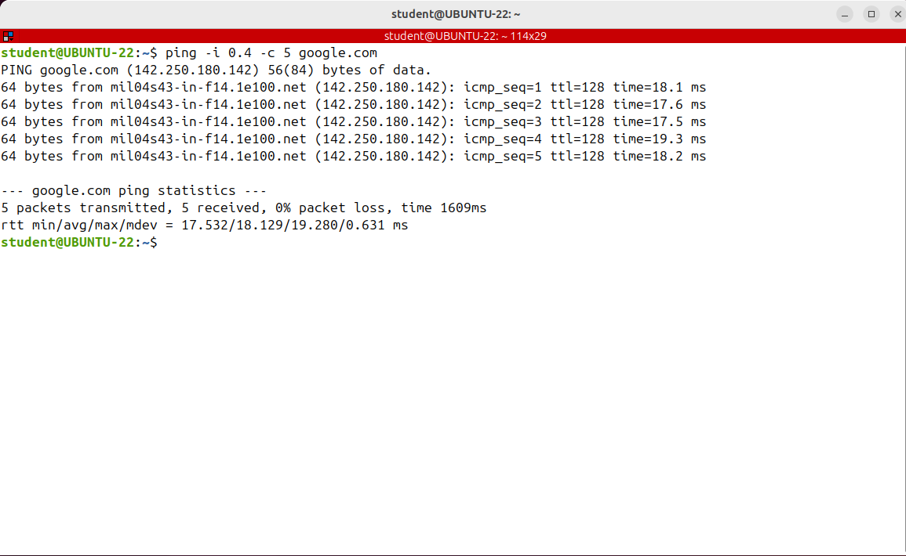

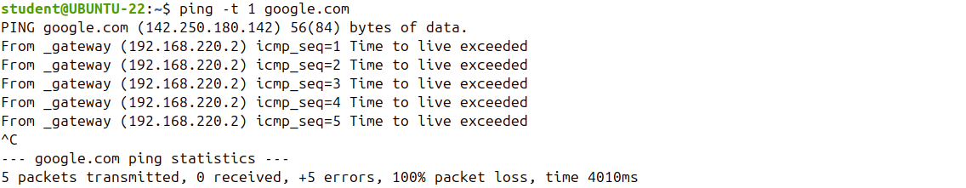
Testing and Troubleshooting Network Connectivity
By default, Ping waits one second before sending the next packet.
We can change this interval with -i option
Only the superuser may set this interval to values less than 0.2 seconds.
If you only want to get a summary, use the minus Q option

Slide 15
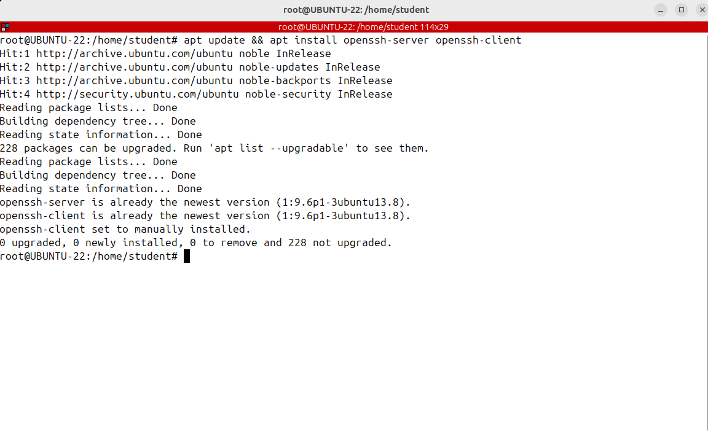
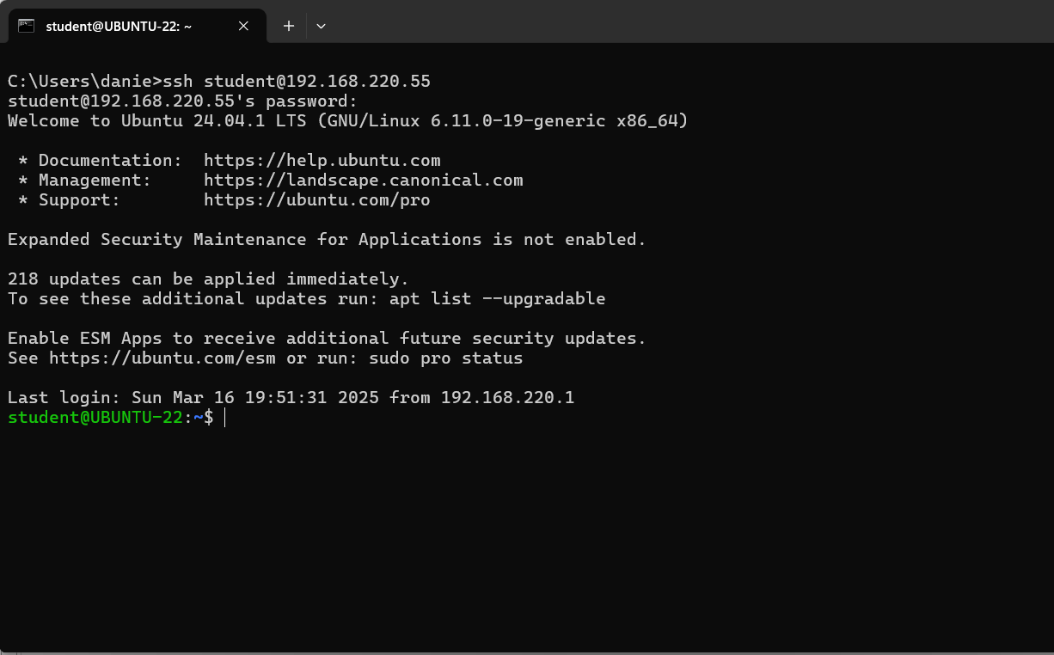
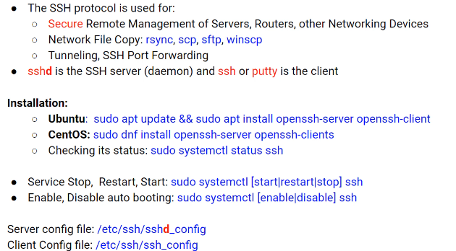
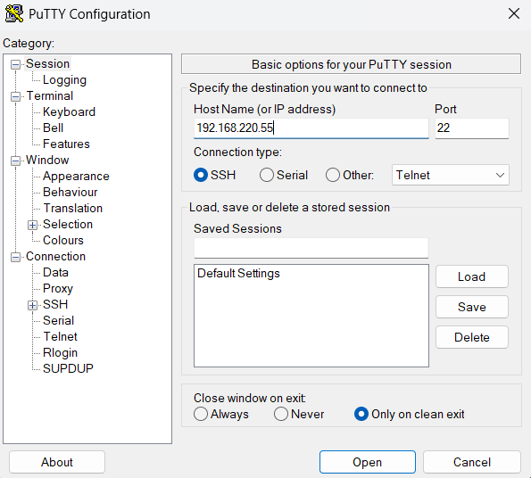
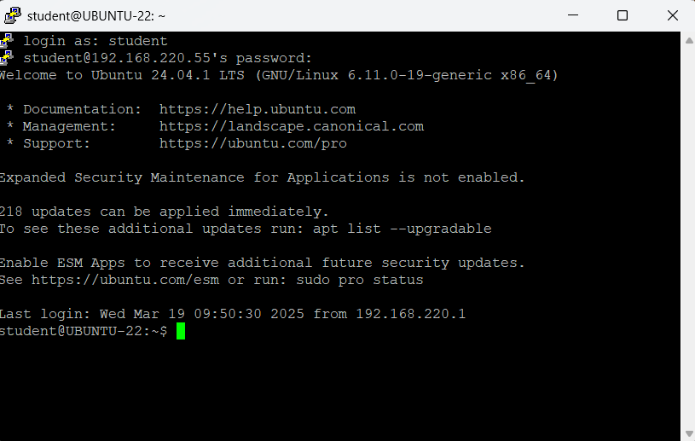
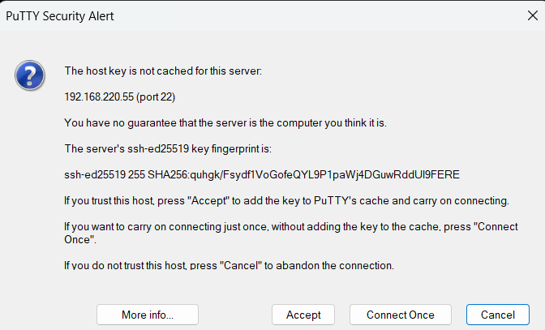
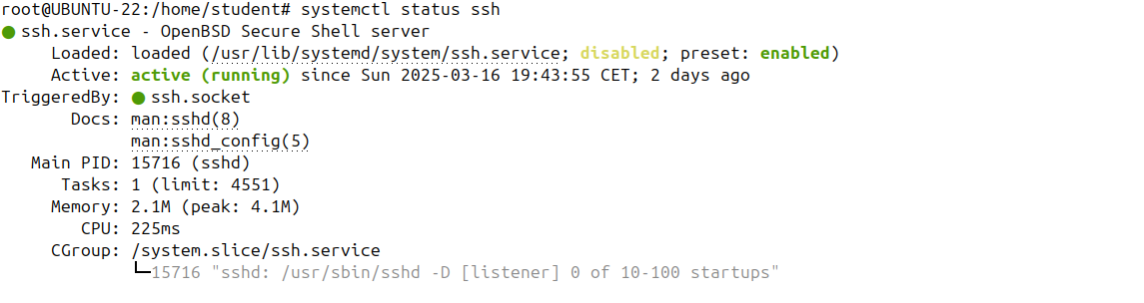
Using SSH

Slide 16
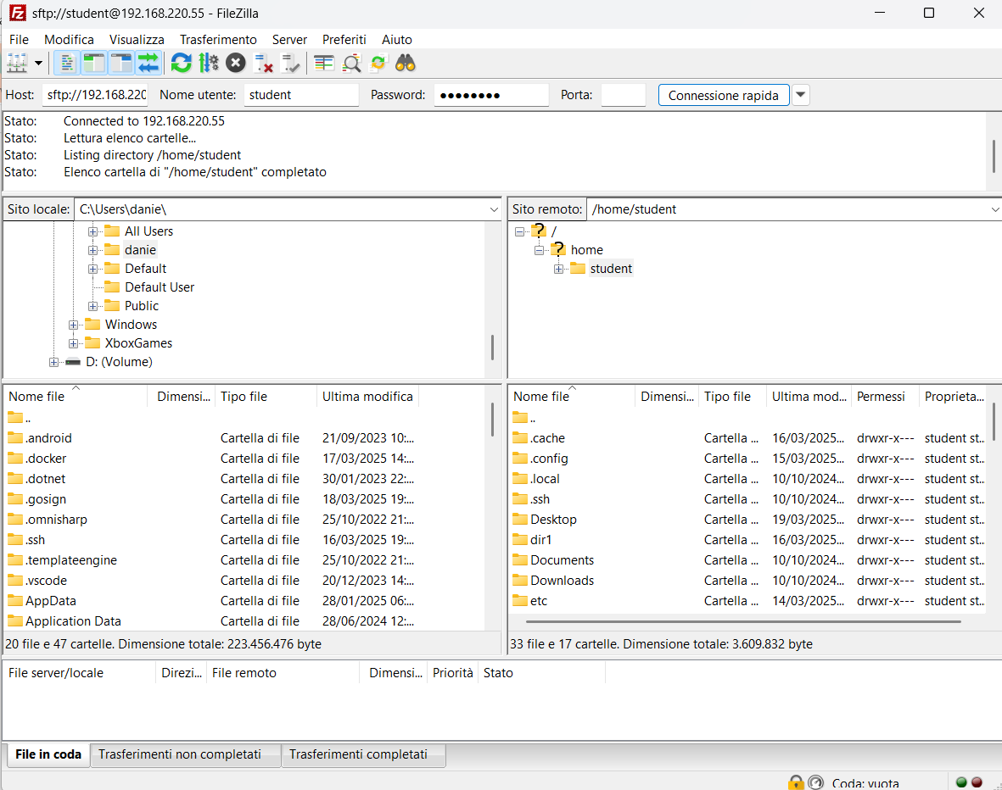
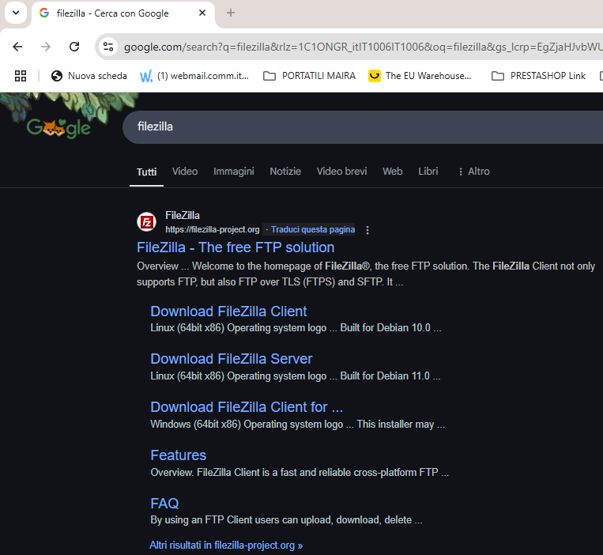
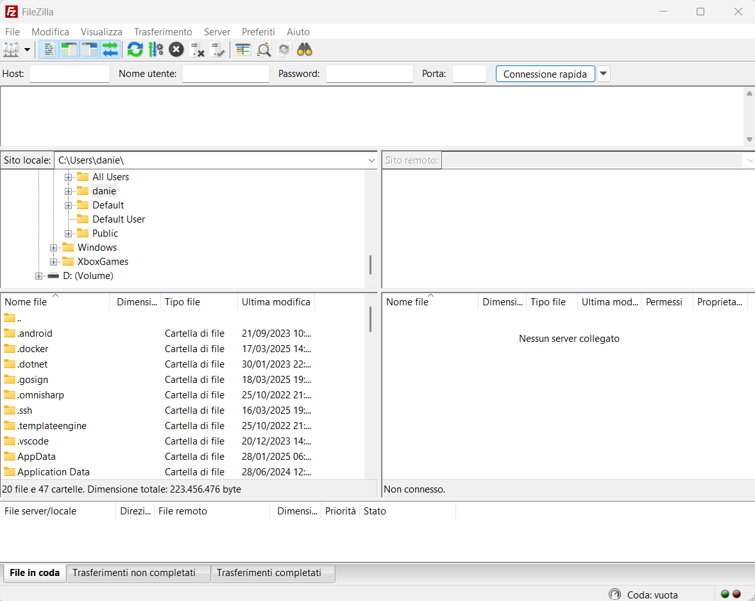
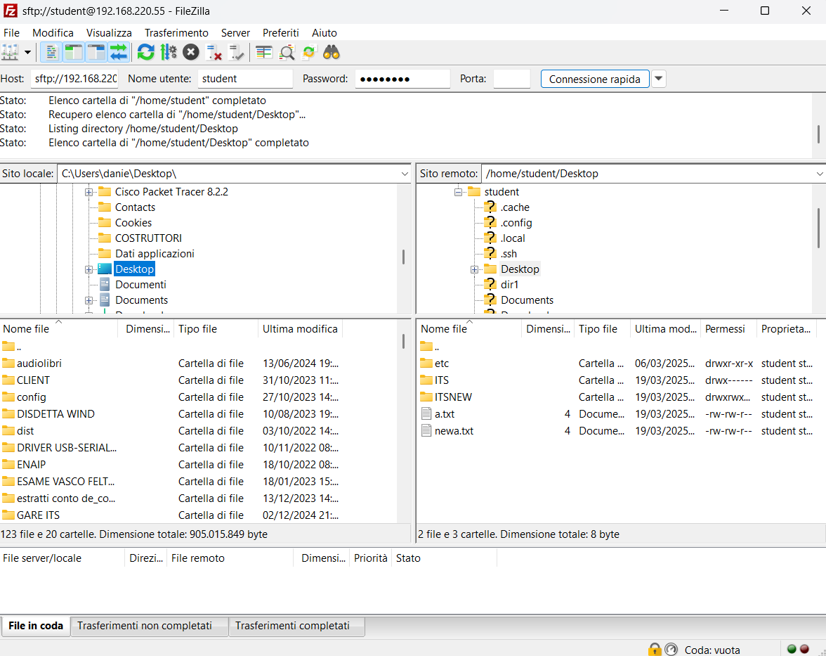


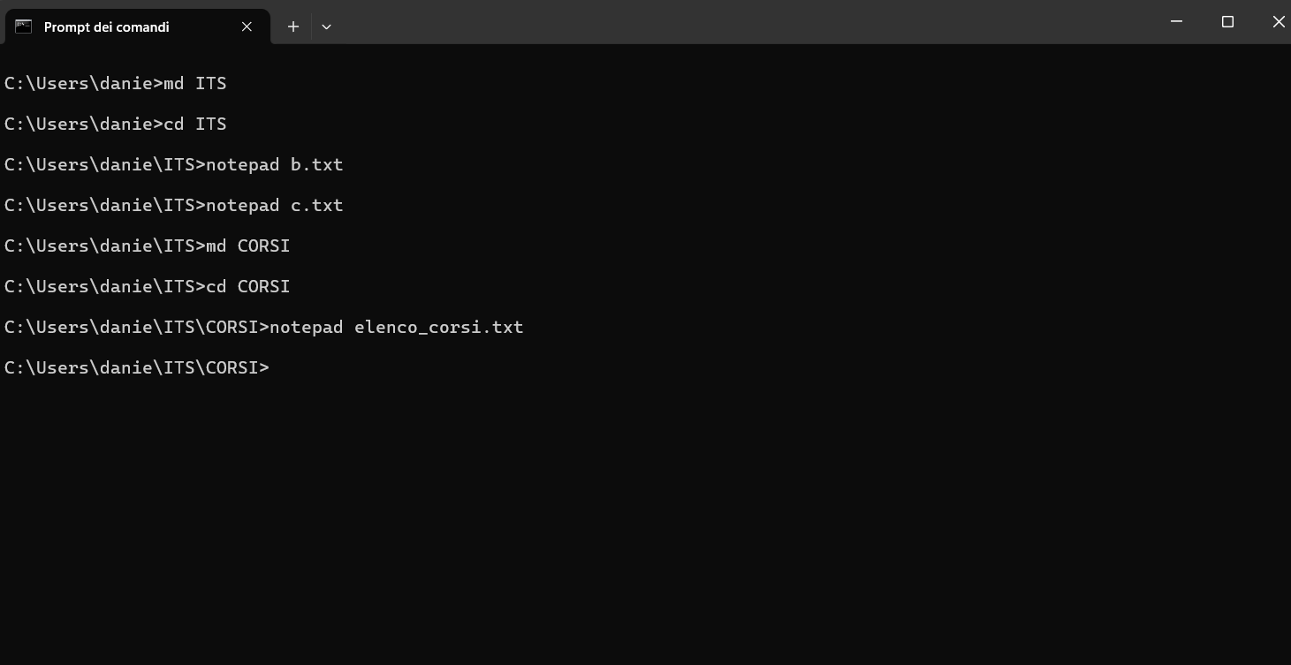





















Copying Files Over the Network (scp)
It’s time to talk about scp which stands for secure copy and allows you to securely copy files and directories between two hosts using SSH. This command will copy over an ssh connection and it’s very useful for a lot of things that require files to be transferred over the Network.
We want copy a file from WINDOWS TO LINUX
Please open a windows command prompt
There are some GUIs available for SFTP so that you can transfer files from one machine to another using
SFTP and SSH in graphical mode.
A well known implementation of an SFTP client is WinSCP for Windows or FileZilla, which is a
crossplatform client and works on Windows, Linux and Mac.
PLEASE install Filezilla on your windows machine
To copy a file or a directory from a remote to a local system used the remote
Location as source and the local location as destination.

Slide 17









Synchronizing Files and Directories using rsync
The -a option is telling rsync to run in archive mode and it means it will copy directories
recursively, preserve symlinks, the owner, the group and the permissions. It will copy the files as they are.
The -v option indicates to run in verbose mode. rsync will print out everything it does.
If the destination directory does not exist, rsync will create it.
If now I'm removing the file from the source location.
I'm running the rsync command again, expecting to remove the file from the destination location as well.
But the file was not removed from the destination. It's in the destination directory.
To make rsync remove such files add the --delete option. This is useful for mirroring, when you want two directories to always have the same contents.
Rsync is a fast and versatile utility that synchronizes files and directories between two locations that can be local or remote.
Think of rsync as of a very complex command, with tons of options, that is widely used for backups and mirroring. It’s like an improved copy command.
rsync is preinstalled on all major Linux distributions and on Mac OS.
Let's get started with a basic example:
Now, let's suppose something has changed in the sourse location, like, for example, the user has changed b.txt file
Rsync finds files that need to be transferred using a quick check algorithm that looks for files that have changed in size or in last modified time. Since no file was exchanged, rsync does nothing.
if you don't want to display output messages
use the -q option, which stands for quiet instead of v.
Let's see what will happen if new files are created in the sourse location. As route I'm creating a new file z.txt in ITS directory
Though it looks like it does the same as cp, in fact, it doesn't; if I run the command again, it won’t copy the same files in directories.
Suppose you want a backup sn your directory where important files resides.
Instead of copying the directory using the scp command you can use rsync

Slide 18

Synchronizing Files and Directories using rsync
ATTENTION:Until now, we gave no importance to a trailing slash in a directory name.
So cd /etc/ is the same as cd /etc without a trailing slash or ls /etc is the same as ls /etc/
However, rysinc gives different treatment to the source directories with a trialing slash.
If you add a trailing slash to the source directory name, it will copy only the contents of the directory to the destination directory.
If the trailing slash is omitted, rysinc will copy the source directory itself inside the destination
directory.

Slide 19

Synchronizing Files and Directories using rsync
Sometimes you want to exclude some specific file types from synchronization. When I back up my personal files.
I want to exclude the files that are extremely large, like movies or files that are not important to me.
To exclude files and directories use the --exclude files option.
I want rsync exclude from synchronization movie.mkv, dir1 and all files of type .mp3.
To do that, I'm creating a new file and on each line I'll write a file or directory name to be excluded.

Slide 20





Synchronizing Files and Directories using rsync

Slide 21

Synchronizing Files and Directories using rsync
If you want to quickly exclude a file or a directory there’s also the --exclude option which takes a file or a directory
as argument in the command line like this: rsync -av --exclude= and between
quotes, a file or directory name to exclude.

Slide 22

COMMANDS – scp, rsync

Slide 23










Using wget
This is a GNU command line utility for downloading files from HTTP, HTTPS of FTP servers.
It provides a number of options, allowing you to download multiple files, resume downloads, limit bandwidth, mirror a website and much more.
The wget package is pre-installed on most Linux distributions, but in case you don’t have
it, simply install it
Let’s see the first example and download Kali Linux as an ISO file that can be later installed
Once the download is complete, you will find the downloaded file in the directory that you have specified.
Please press CTRL+C to abort operation
Once the download is complete, you will find the downloaded file in the current directory.
Please press CTRL+C to abort operation
If you want to save the file into another
Directory use the capital P option

Slide 24

Using wget
If you want to limit the download speed, so that wget does not consume the entire available bandwidth, use the --limit-rate option
Please press CTRL+C to abort operation

Slide 25


Using wget
We wanto know how to resume an interrupted download;
by default if the connection drops while wget is downloading the file next time when you try to resume it, it will start from the beginning.
To resume or download, use the -C option. I'm starting it again and at 100 megabytes I'll interrupted. Then I’ll resume….

Slide 26





Using wget
If you want to download multiple files at once, you can use the -i option and the path to a file
which contains each url on its own line.

Slide 27


Using wget
Sometimes you want to create an offline copy of a site that you can take in view
even without the Internet access. Using wget you can do it easily.

Slide 28

COMMANDS wget

Slide 29








QUIZ TIME

